Slide 1
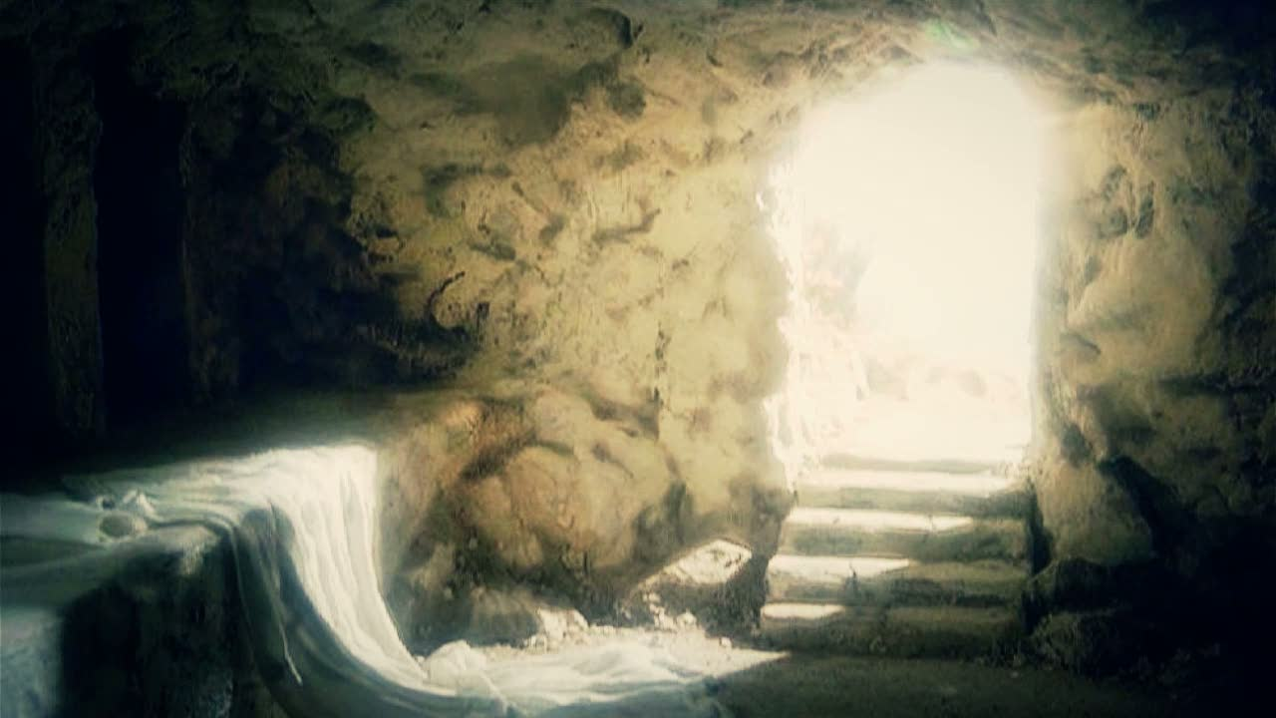
Joy and the Resurrection
Selected Texts
Sunday, April 09, 2023

Slide 2
Andrew Murray
“A dead Christ I must do everything for; a living Christ does everything for me.”

Slide 3
Philippians 4:4
Rejoice in the Lord always, again I will say, rejoice!

Slide 4
1 Thessalonians 5:16-18
16 Rejoice always; 17 pray without ceasing; 18 in everything give thanks; for this is God’s will for you in Christ Jesus.

Slide 5
James 1:2-4
2 Consider it all joy, my brethren, when you encounter various trials,
3 knowing that the testing of your faith produces endurance. 4 And let endurance have its perfect result, so that you may be perfect and complete, lacking in nothing.

Slide 6
Ecclesiastes 3:1, 4
1 There is an appointed time for everything. And there is a time for every event under heaven. ... 4 A time to weep and a time to laugh; A time to mourn and a time to dance.

Slide 7
2 Corinthians 6:10
…as sorrowful yet always rejoicing…

Slide 8
Joy and the Resurrection
Joy in the unexpected (Matthew 28:1-8)
1 Now after the Sabbath, as it began to dawn toward the first day of the week, Mary Magdalene and the other Mary came to look at the grave. 2 And behold, a severe earthquake had occurred, for an angel of the Lord descended from heaven and came and rolled away the stone and sat upon it. 3 And his appearance was like lightning, and his clothing as white as snow. 4 The guards shook for fear of him and became like dead men. 5 The angel said to the women, “Do not be afraid; for I know that you are looking for Jesus who has been crucified. 6 He is not here, for He has risen, just as He said. Come, see the place where He was lying. 7 Go quickly and tell His disciples that He has risen from the dead; and behold, He is going ahead of you into Galilee, there you will see Him; behold, I have told you.” 8 And they left the tomb quickly with fear and great joy and ran to report it to His disciples.

Slide 9
Matthew 27:59-61
59 And Joseph took the body and wrapped it in a clean linen cloth, 60 and laid it in his own new tomb, which he had hewn out in the rock; and he rolled a large stone against the entrance of the tomb and went away. 61 And Mary Magdalene was there, and the other Mary, sitting opposite the grave.

Slide 10
Matthew 28:5-7
5 The angel said to the women, “Do not be afraid; for I know that you are looking for Jesus who has been crucified. 6 He is not here, for He has risen, just as He said. Come, see the place where He was lying. 7 Go quickly and tell His disciples that He has risen from the dead; and behold, He is going ahead of you into Galilee, there you will see Him; behold, I have told you.”

Slide 11
Joy and the Resurrection
Joy in the unexpected (Matthew 28:1-8)
Joy in the realization (Luke 24)

Slide 12
Luke 24:36-42
36 While they were telling these things, He Himself stood in their midst and said to them, "Peace be to you." 37 But they were startled and frightened and thought that they were seeing a spirit. 38 And He said to them, "Why are you troubled, and why do doubts arise in your hearts? 39 "See My hands and My feet, that it is I Myself; touch Me and see, for a spirit does not have flesh and bones as you see that I have." 40 And when He had said this, He showed them His hands and His feet. 41 While they still could not believe it because of their joy and amazement, He said to them, "Have you anything here to eat?" 42 They gave Him a piece of a broiled fish; 43 and He took it and ate it before them.

Slide 13
Psalm 126:1-3
1 When the LORD brought back the captive ones of Zion, We were like those who dream. 2 Then our mouth was filled with laughter And our tongue with joyful shouting; Then they said among the nations, "The LORD has done great things for them." 3 The LORD has done great things for us; We are glad.

Slide 14
Luke 24:41
While they still could not believe it because of their joy and amazement…

Slide 15
Luke 24:50-53
50 And He led them out as far as Bethany, and He lifted up His hands and blessed them. 51 While He was blessing them, He parted from them and was carried up into heaven. 52 And they, after worshiping Him, returned to Jerusalem with great joy, 53 and were continually in the temple praising God.

Slide 16
Acts 17:6
When they did not find them, they began dragging Jason and some brethren before the city authorities, shouting, "These men who have upset the world have come here also… (NASB95)
6 And when they could not find them, they dragged Jason and some of the brothers before the city authorities, shouting, "These men who have turned the world upside down have come here also… (ESV)

Slide 17
Joy and the Resurrection
Joy in the unexpected (Matthew 28:1-8)
Joy in the realization (Luke 24)
Joy in believing (Acts 13)

Slide 18
Acts 13:14-16
14 But going on from Perga, they arrived at Pisidian Antioch, and on the Sabbath day they went into the synagogue and sat down. 15 After the reading of the Law and the Prophets the synagogue officials sent to them, saying, "Brethren, if you have any word of exhortation for the people, say it." 16 Paul stood up, and motioning with his hand said, "Men of Israel, and you who fear God, listen:

Slide 19
Acts 13:26-31
26 "Brethren, sons of Abraham's family, and those among you who fear God, to us the message of this salvation has been sent. 27 "For those who live in Jerusalem, and their rulers, recognizing neither Him nor the utterances of the prophets which are read every Sabbath, fulfilled these by condemning Him. 28 "And though they found no ground for putting Him to death, they asked Pilate that He be executed. 29 "When they had carried out all that was written concerning Him, they took Him down from the cross and laid Him in a tomb. 30 "But God raised Him from the dead; 31 and for many days He appeared to those who came up with Him from Galilee to Jerusalem, the very ones who are now His witnesses to the people.

Slide 20
Acts 13:32-37
32 "And we preach to you the good news of the promise made to the fathers, 33 that God has fulfilled this promise to our children in that He raised up Jesus, as it is also written in the second Psalm, 'YOU ARE MY SON; TODAY I HAVE BEGOTTEN YOU.' 34 "As for the fact that He raised Him up from the dead, no longer to return to decay, He has spoken in this way: 'I WILL GIVE YOU THE HOLY and SURE blessings OF DAVID.' 35 "Therefore He also says in another Psalm, 'YOU WILL NOT ALLOW YOUR HOLY ONE TO UNDERGO DECAY.’ 36 "For David, after he had served the purpose of God in his own generation, fell asleep, and was laid among his fathers and underwent decay; 37 but He whom God raised did not undergo decay.

Slide 21
Acts 13:38-41
38 "Therefore let it be known to you, brethren, that through Him forgiveness of sins is proclaimed to you, 39 and through Him everyone who believes is freed from all things, from which you could not be freed through the Law of Moses. 40 "Therefore take heed, so that the thing spoken of in the Prophets may not come upon you: 41 'BEHOLD, YOU SCOFFERS, AND MARVEL, AND PERISH; FOR I AM ACCOMPLISHING A WORK IN YOUR DAYS, A WORK WHICH YOU WILL NEVER BELIEVE, THOUGH SOMEONE SHOULD DESCRIBE IT TO YOU.'"

Slide 22
1 Corinthians 15:1, 3-4
1 Now I make known to you, brethren, the gospel which I preached to you, which also you received, in which also you stand…3 For I delivered to you as of first importance what I also received, that Christ died for our sins according to the Scriptures, 4 and that He was buried, and that He was raised on the third day according to the Scriptures,

Slide 23
Acts 13:44-47
44 The next Sabbath nearly the whole city assembled to hear the word of the Lord. 45 But when the Jews saw the crowds, they were filled with jealousy and began contradicting the things spoken by Paul, and were blaspheming. 46 Paul and Barnabas spoke out boldly and said, "It was necessary that the word of God be spoken to you first; since you repudiate it and judge yourselves unworthy of eternal life, behold, we are turning to the Gentiles. 47 "For so the Lord has commanded us, 'I HAVE PLACED YOU AS A LIGHT FOR THE GENTILES, THAT YOU MAY BRING SALVATION TO THE END OF THE EARTH.'"

Slide 24
Acts 13:48, 49
48 When the Gentiles heard this, they began rejoicing and glorifying the word of the Lord; and as many as had been appointed to eternal life believed.
49 And the word of the Lord was being spread through the whole region.

Slide 25
Joy and the Resurrection
Joy in the unexpected (Matthew 28:1-8)
Joy in the realization (Luke 24)
Joy in believing (Acts 13)
Joy in salvation (1 Peter 1:3-6)
3 Blessed be the God and Father of our Lord Jesus Christ, who according to His great mercy has caused us to be born again to a living hope through the resurrection of Jesus Christ from the dead, 4 to obtain an inheritance which is imperishable and undefiled and will not fade away, reserved in heaven for you, 5 who are protected by the power of God through faith for a salvation ready to be revealed in the last time. 6 In this you greatly rejoice, even though now for a little while, if necessary, you have been distressed by various trials…

Slide 26
Philippians 4:4
Rejoice in the Lord always, again I will say, rejoice!

Slide 27
Joy and the Resurrection
Selected Texts
Sunday, April 09, 2023

